Slide 1
Beer Industry Study
Vincent Ji
February 2020

Slide 2
Agenda
Industry Background
Observations
Takeaways

Slide 3
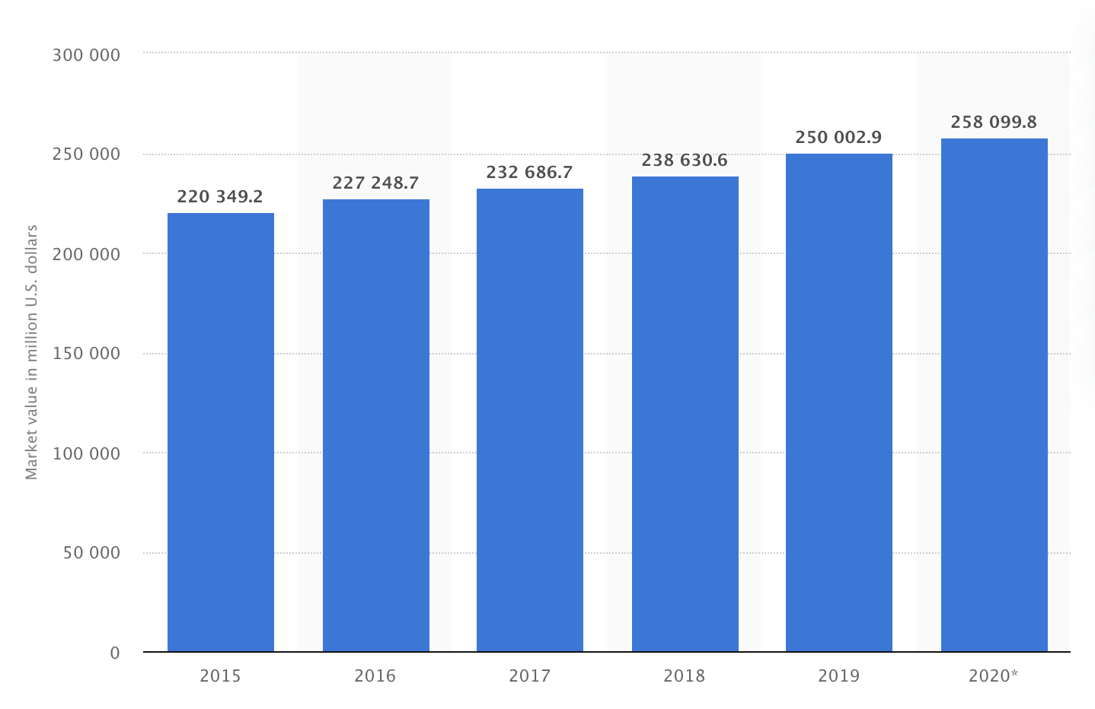
Beer is the most popular alcoholic beverage with sales of over $100B per year.
Alcoholic Beverage Market Size
Market Share Breakdown
Source: Statista

Slide 4
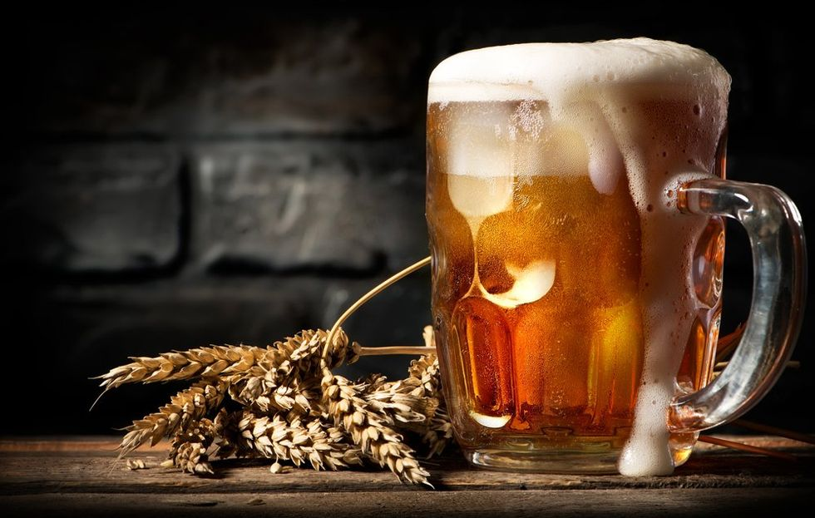
Takeaways
Takeaways
Access to water is crucial consideration for where to operate a brewery.
Certain beer segments such as American IPA and American Pale Ale look saturated. Other styles may offer better growth opportunities.
To create a highly rated beer, you will need to find the optimal alcohol balance within the beer category.

